Slide 1
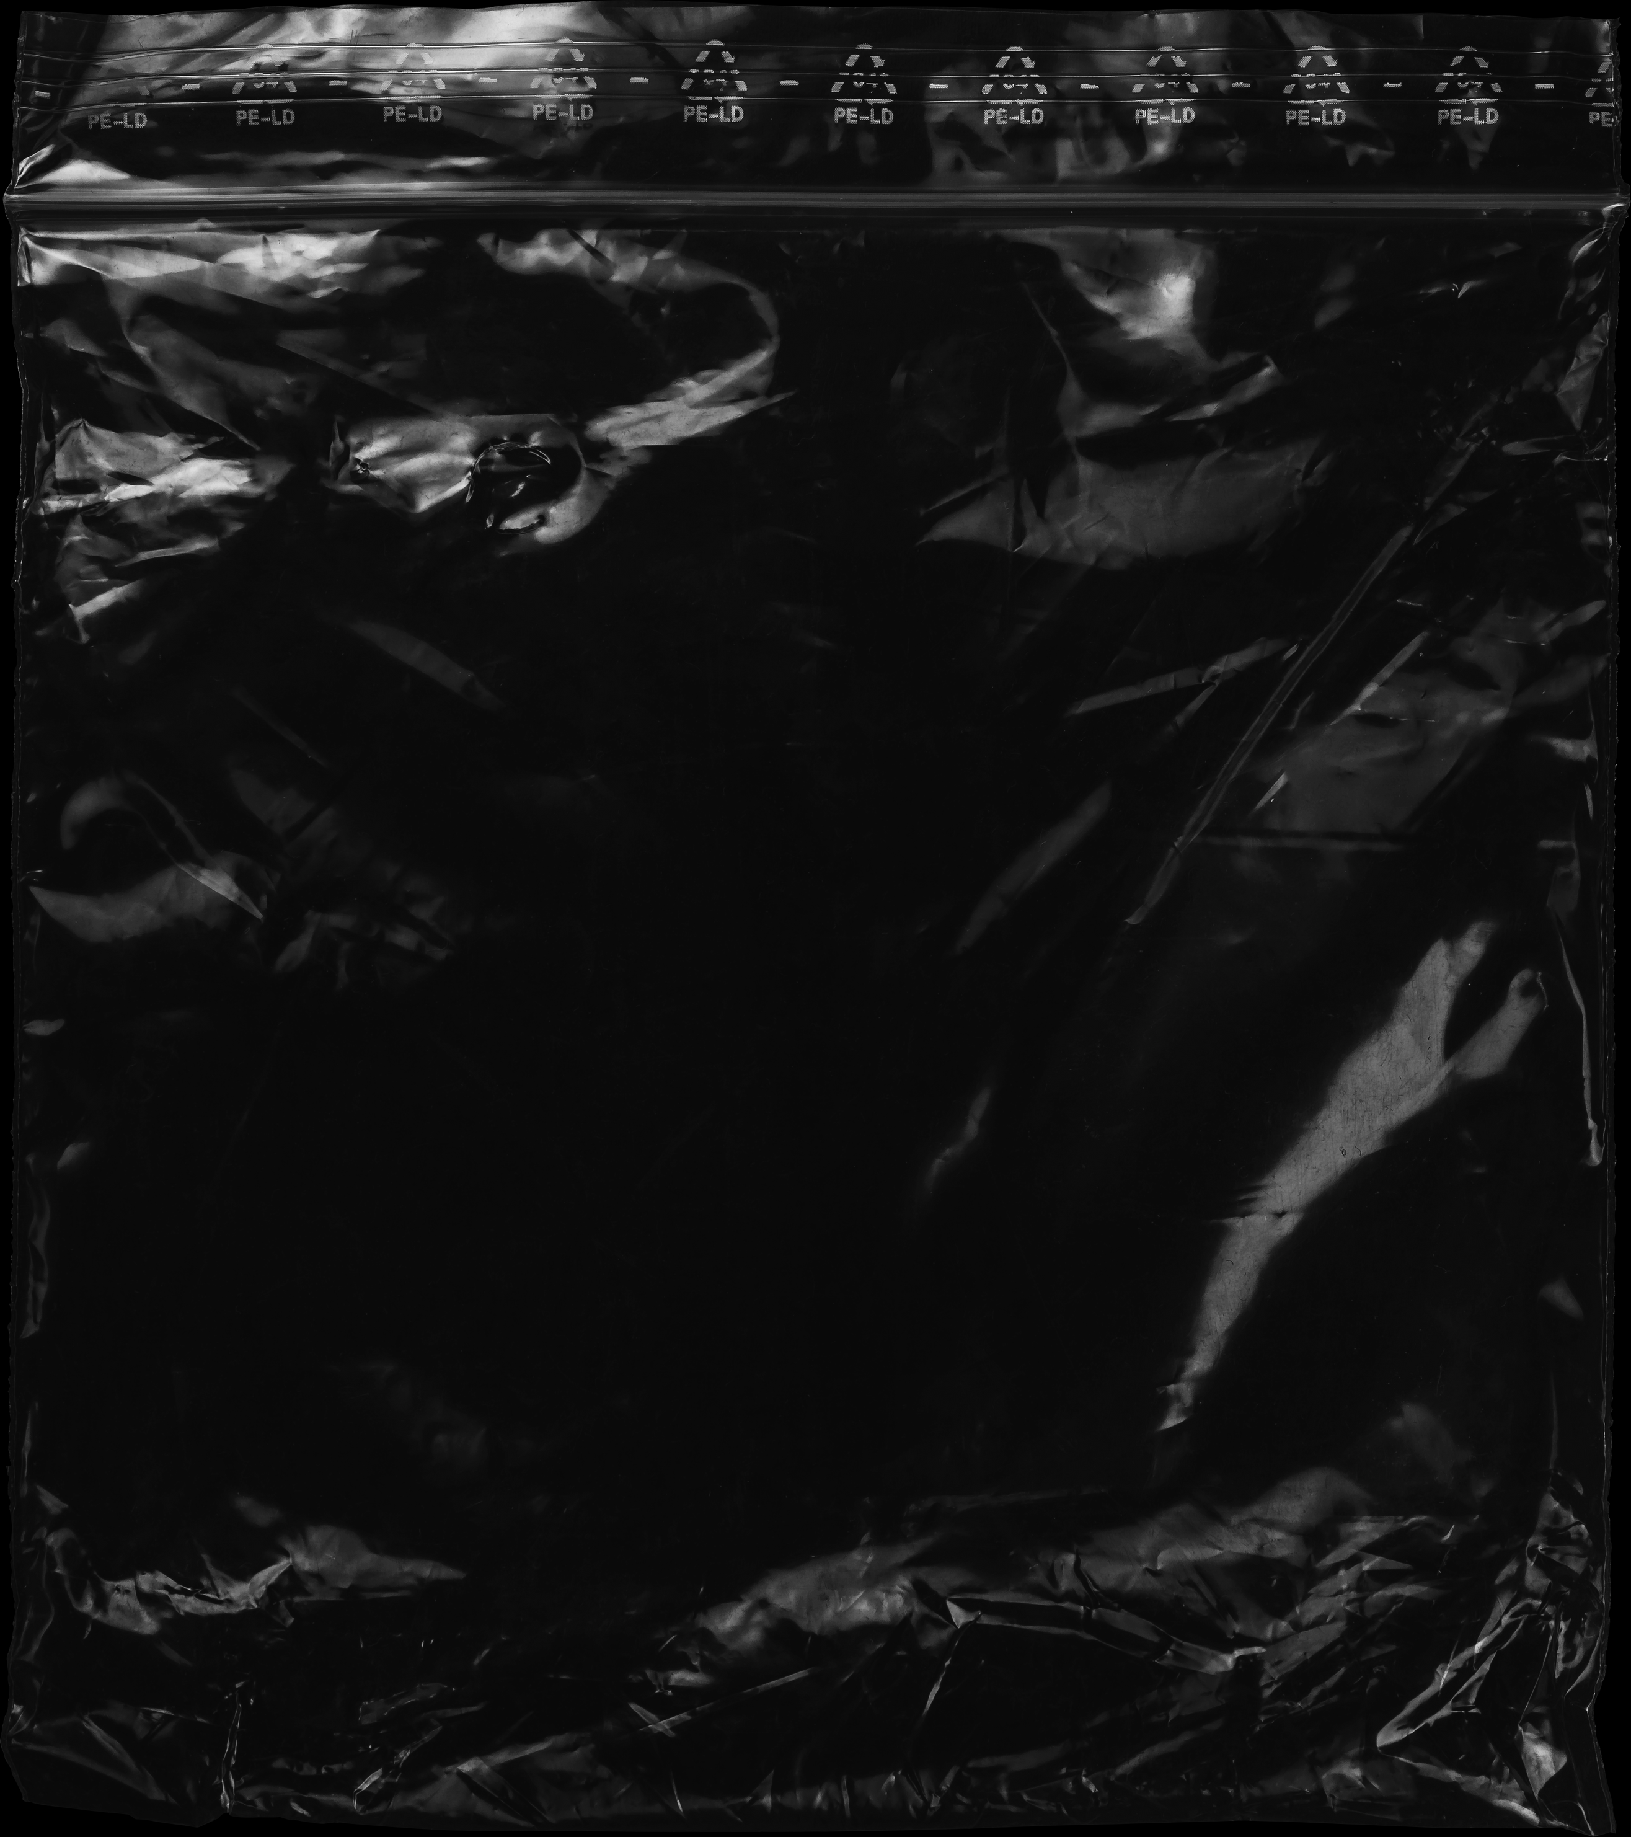

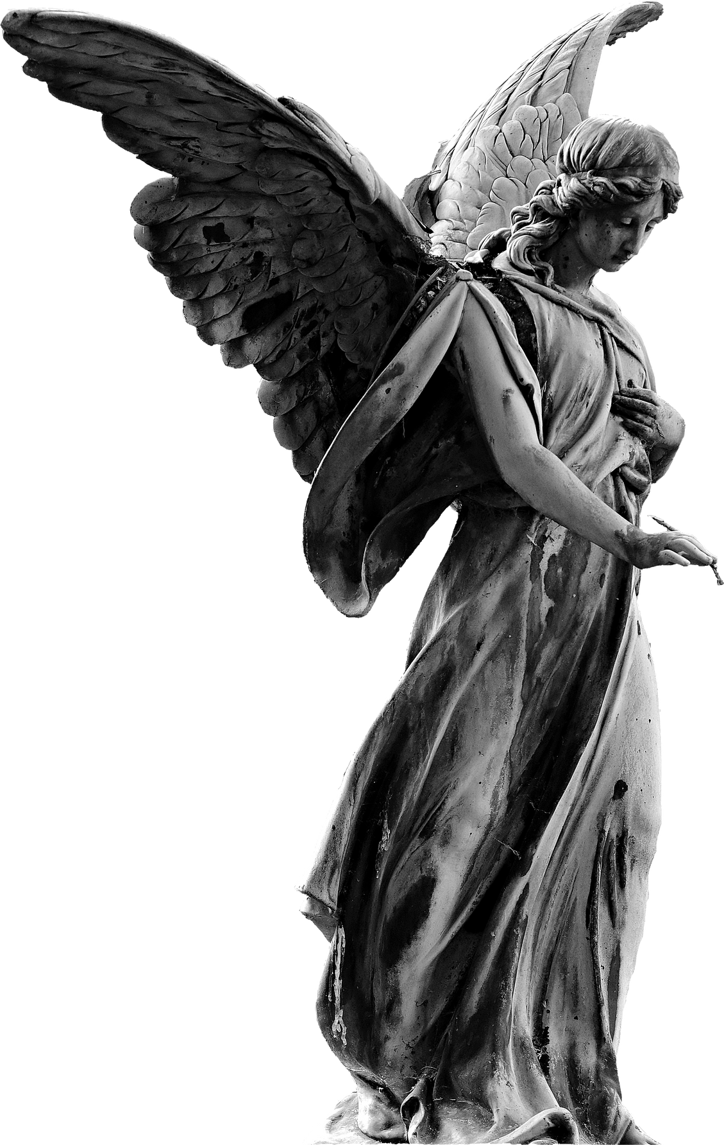

PlatBorne
2.0

Slide 2
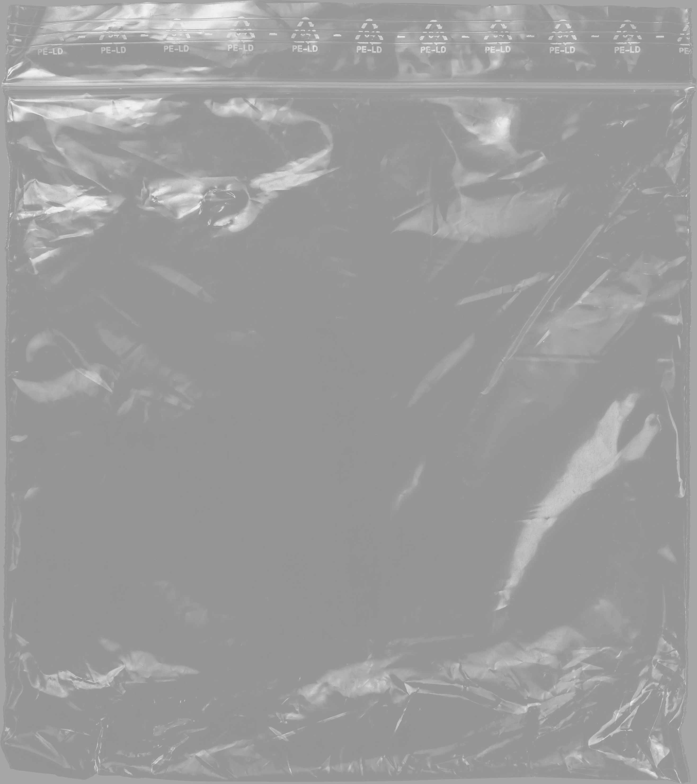
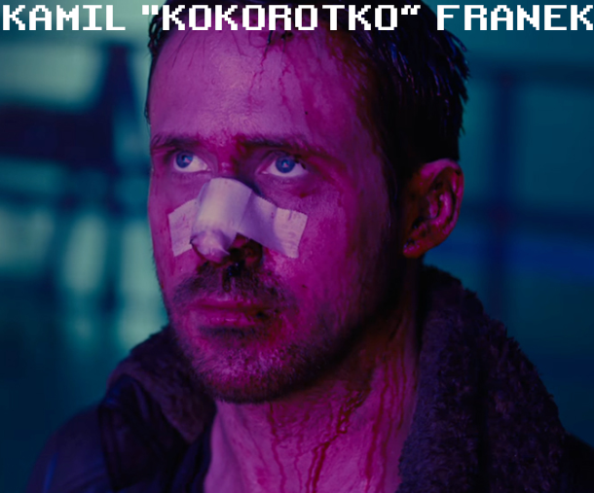
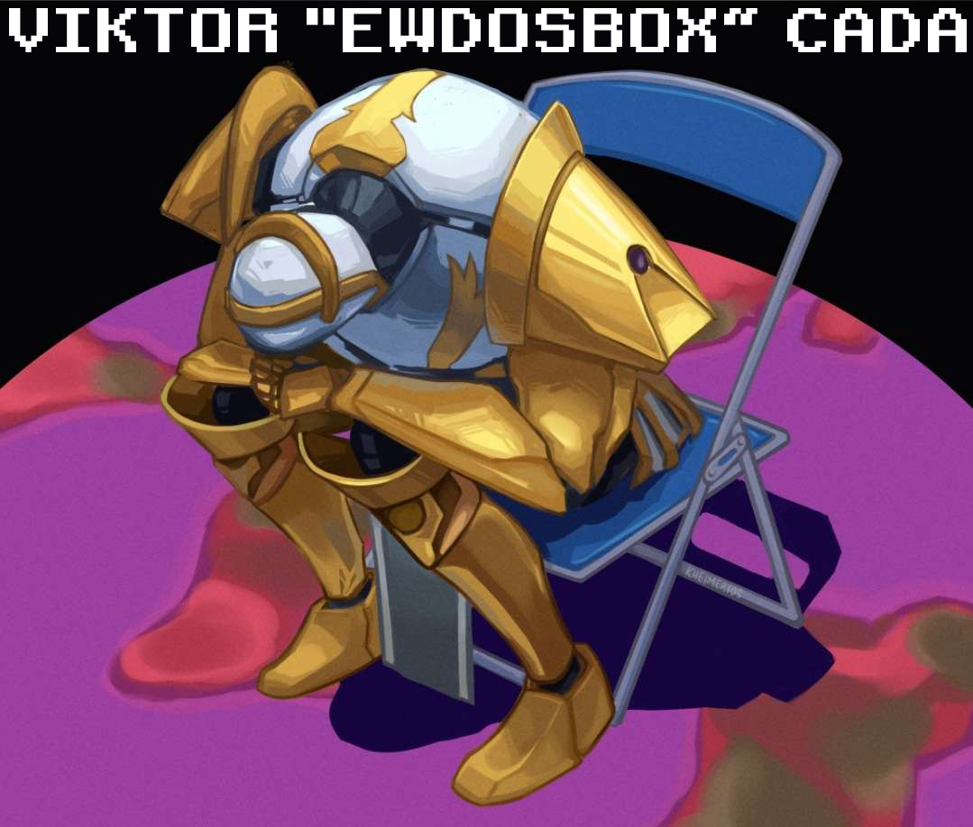
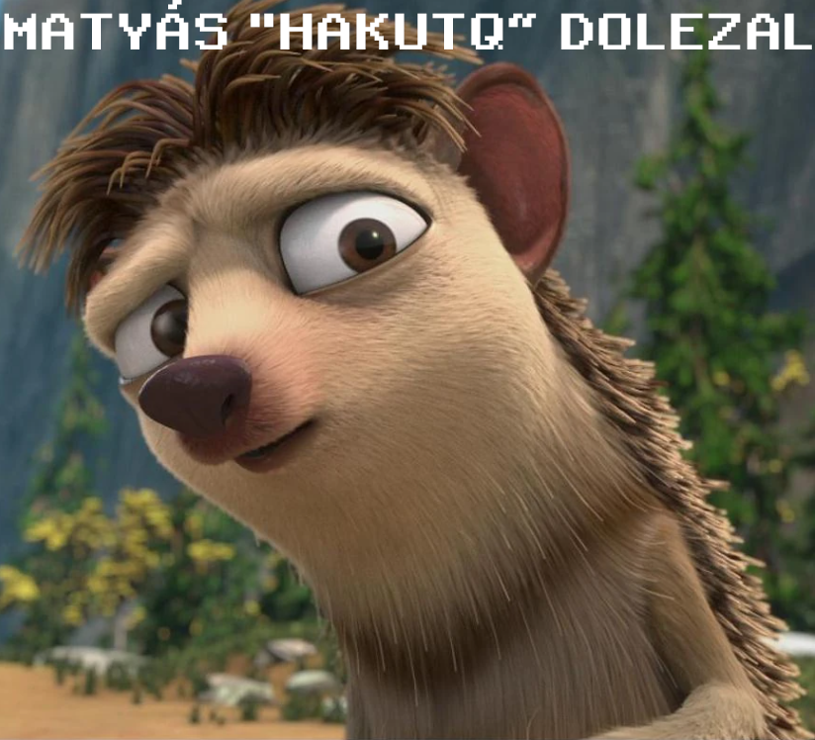
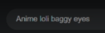
Autism Assemble
Real
Gabriel
Louis
Literárne Já
Literárne Já
Literárne Já

Slide 3
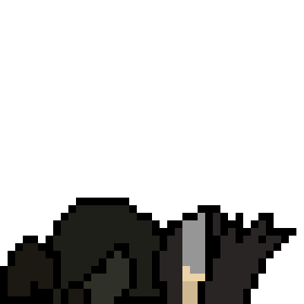

Slide 4

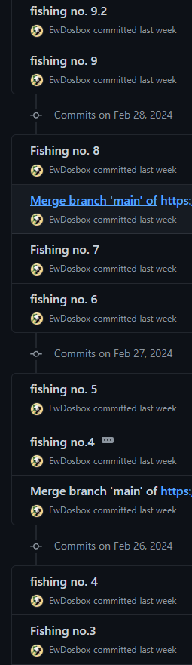

1.
Kamil “Kokorotko” Franek
Main, Boss Programmer
Voice Actor (Brecus)
Lore and Voice Line Writer
SFX and OST Producer
Cutscene Producer
Game Tester
Tým
2.
Matyáš “HakuTq” Doležal
UI Designer and Programmer
Lead Artist
Main Animator
Level And Enviroment Artist and Designer
Game Tester
3.
Viktor “EwDosBox” Čada
Collision Enginner
Gameplay and Fish Programmer
Concept Creator
Lore Consultant
Animator
Gay Tester

Slide 5
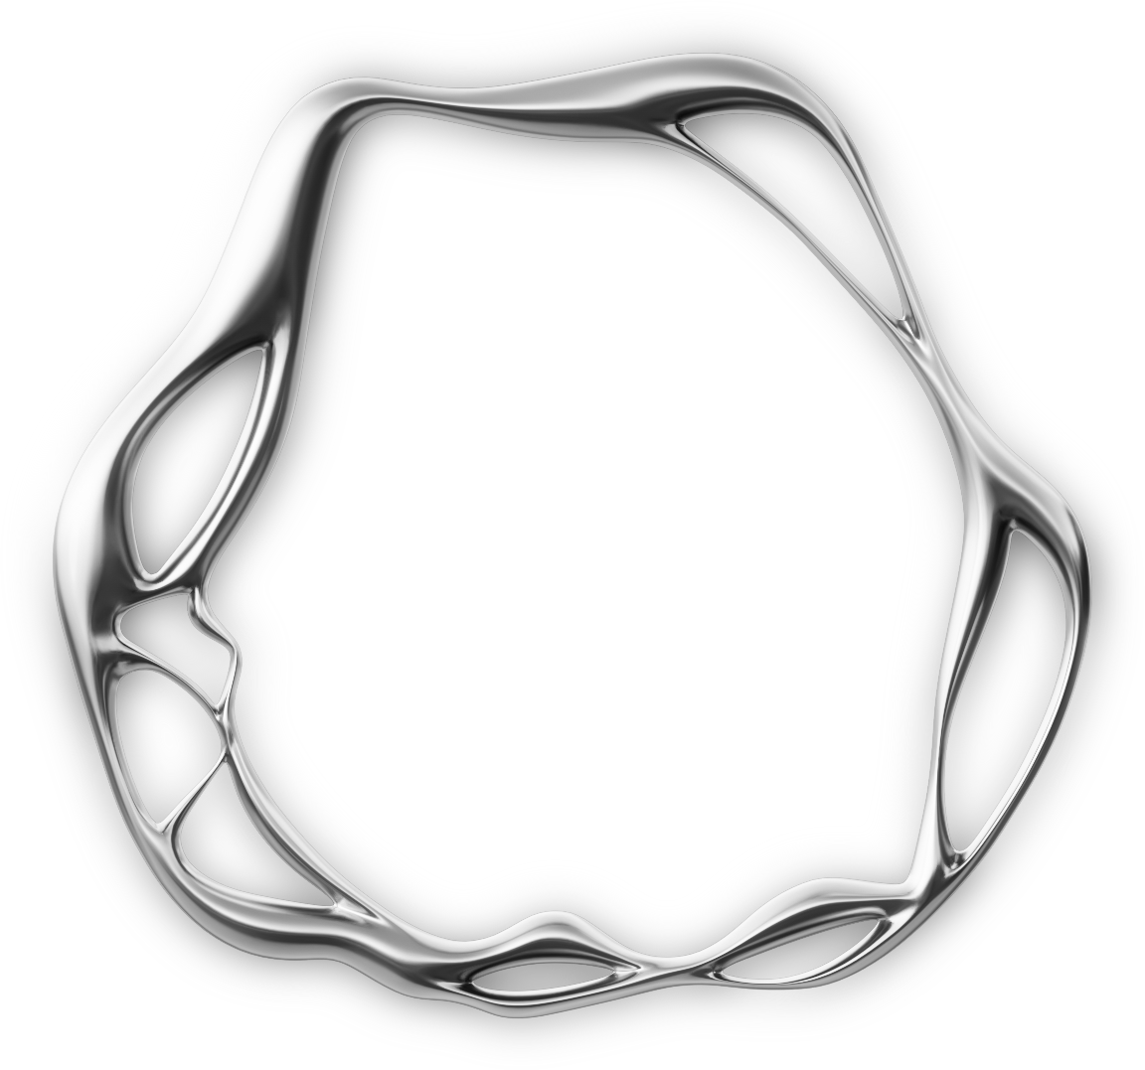
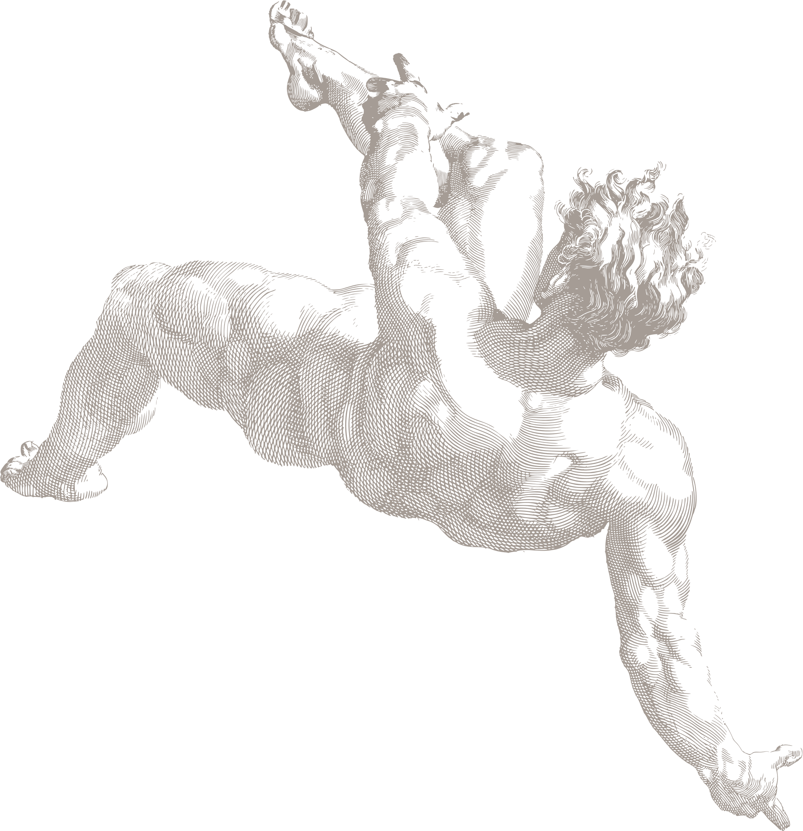

!New Features!

Slide 6
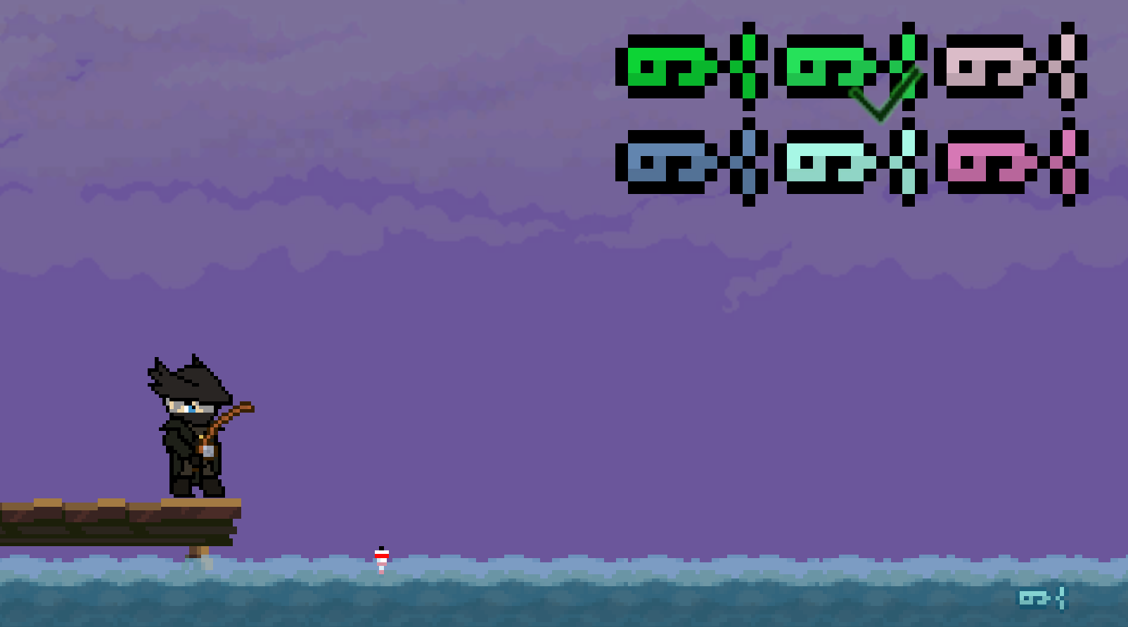
Fish
Nejlepsi
Nejpouzivanejsi
Nejuzitecnejsi
Nejhezci
Nejlepe naprogramovane
Nejlepsi Collidery
Nejlepsi Umela Inteligence
Nejlepsi Animace

Slide 7

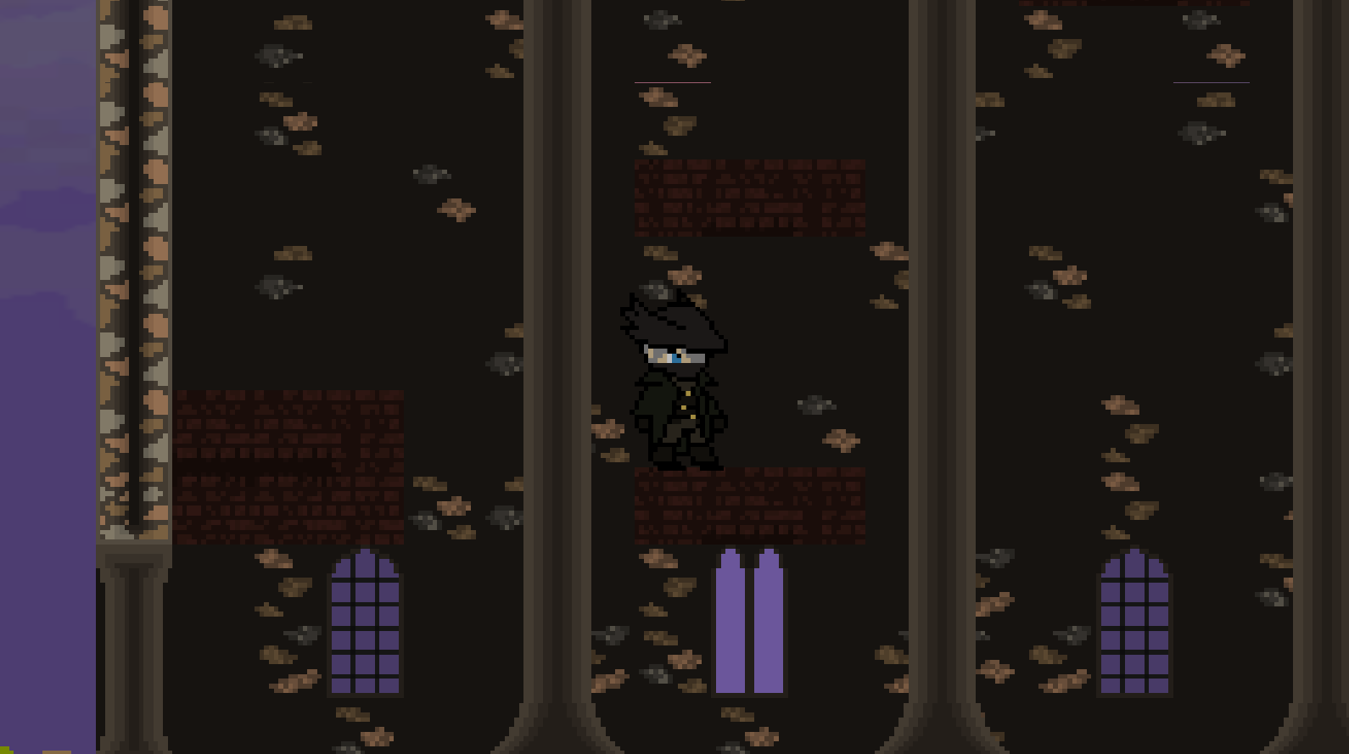
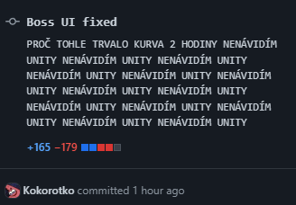
BirgHmingWay
[birgmingweeeee]
Kostely, zvonice a Krtci

Slide 8
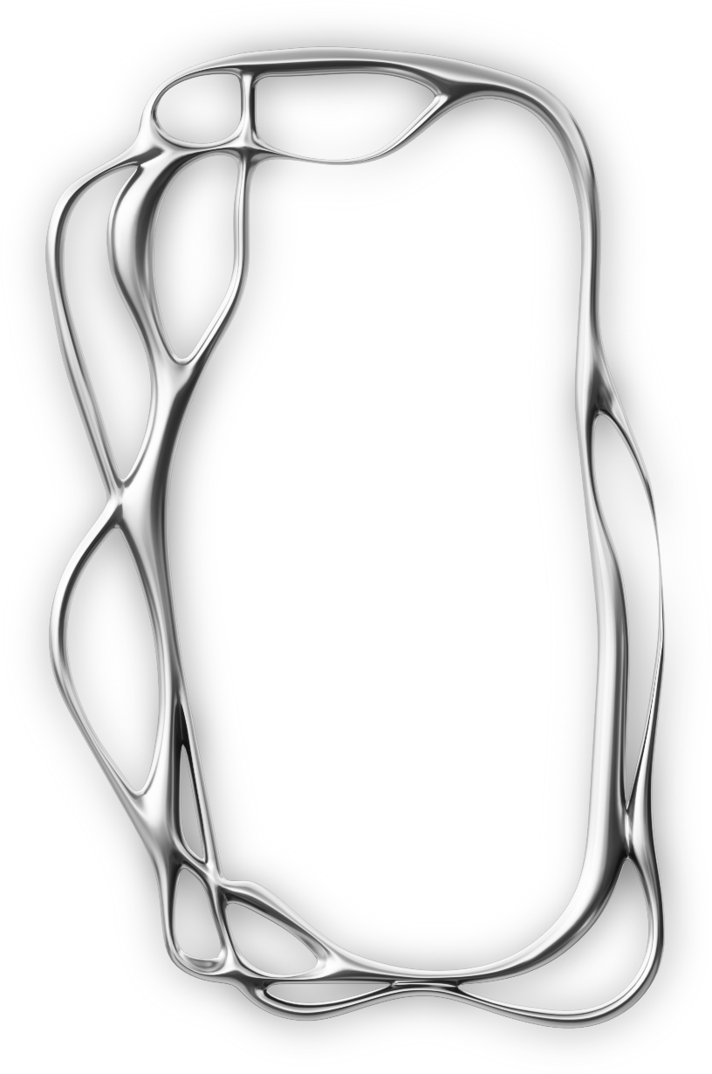
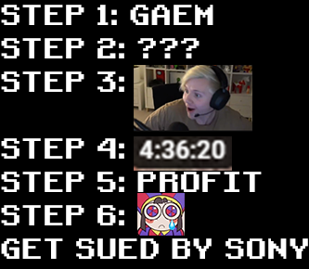
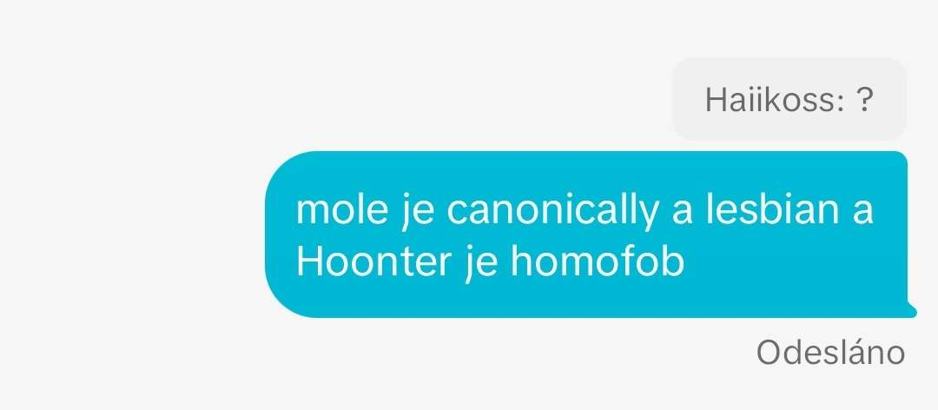
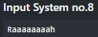
Input System

Slide 9

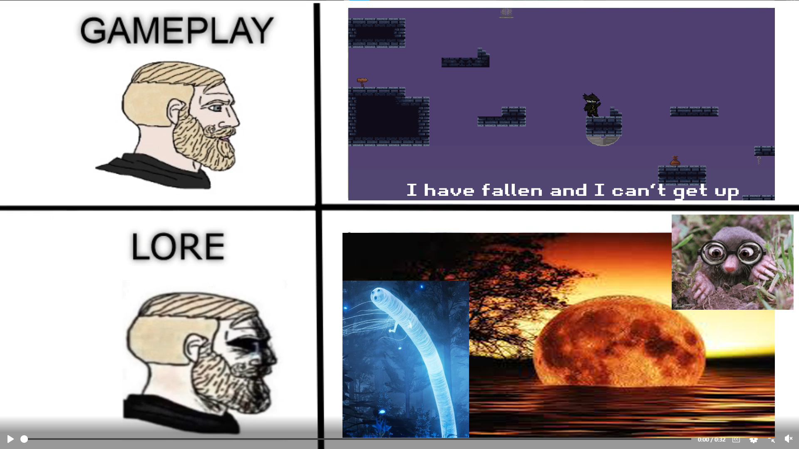

Misc.
Console
Tutorial
Lava
Dash

Slide 10
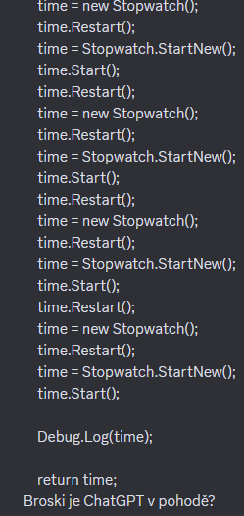

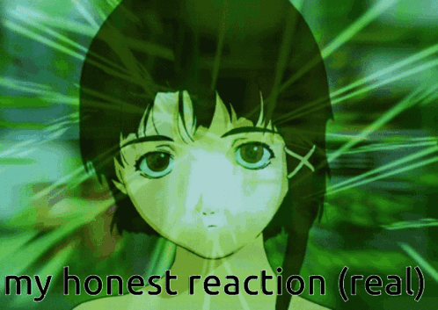
Pouzite Programy
Unity
Freelo
Aseprite
Better
Piskel
VS Studio
FL Studio

Slide 11
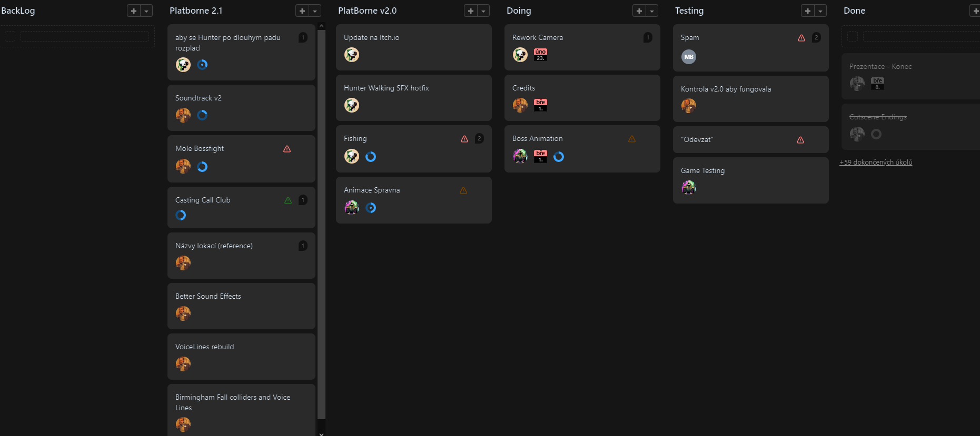
FREELO

Slide 12

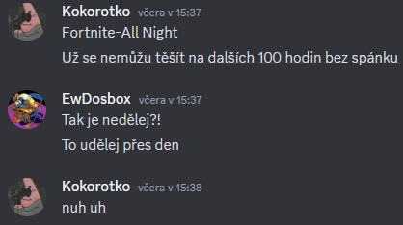
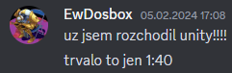
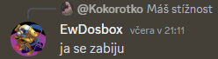
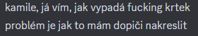
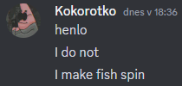
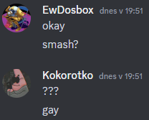
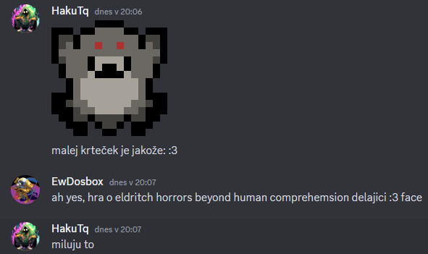
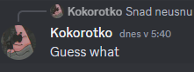
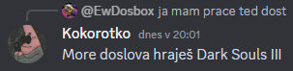
Komunikace

Slide 13
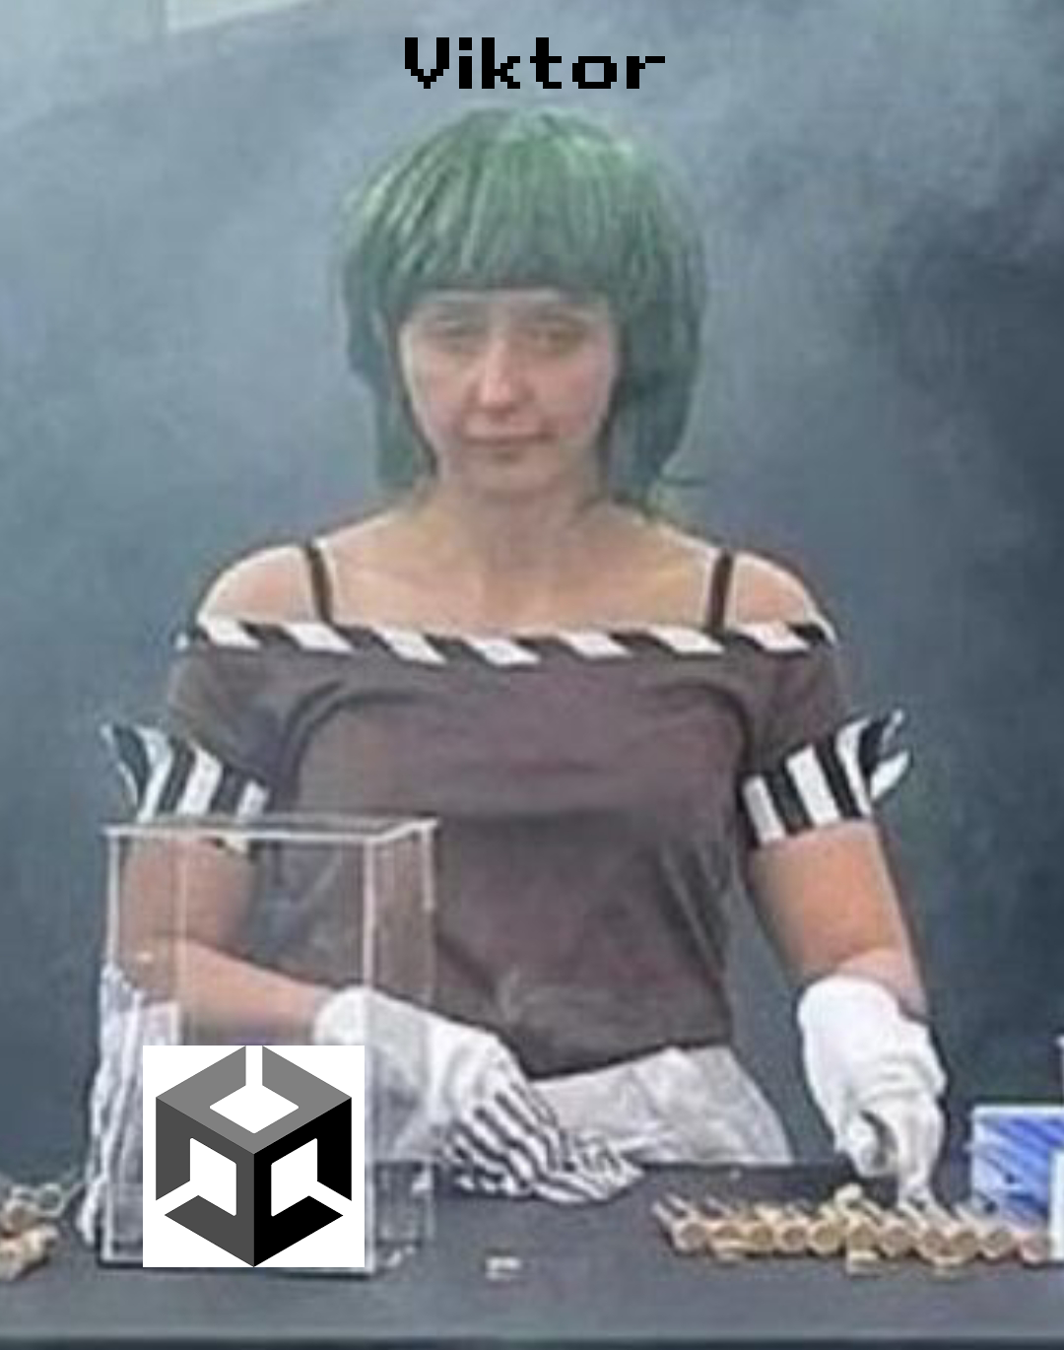
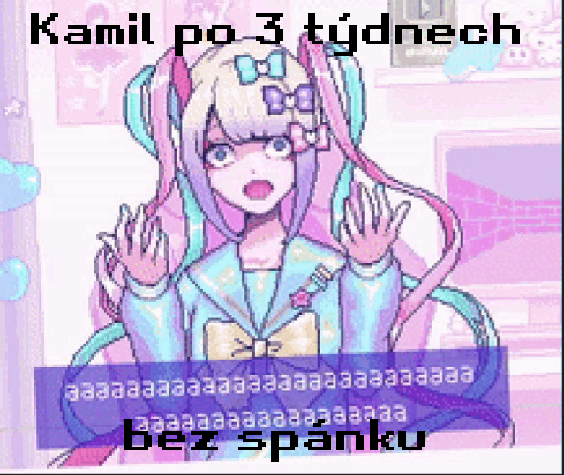
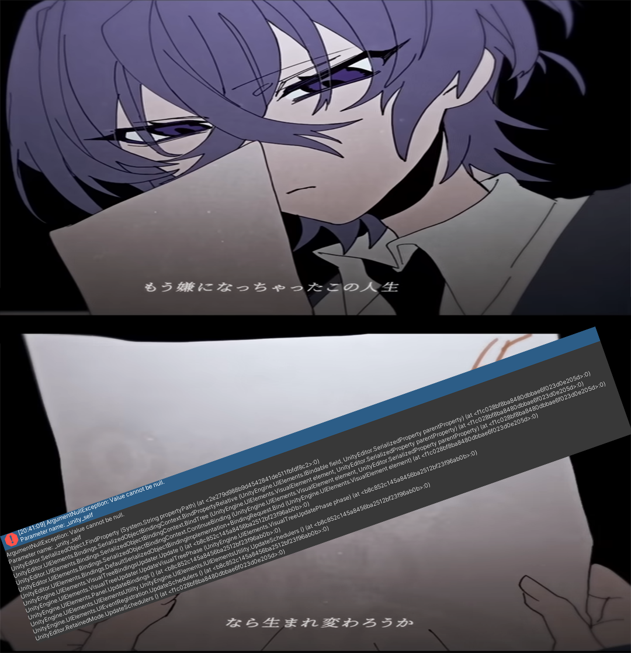
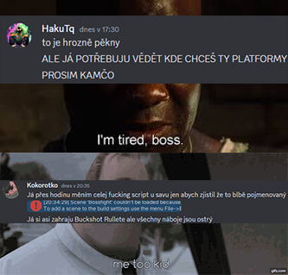
The DNA of The Soul™

Slide 14

Ďakujeme
Ta hra možná byla, ti kamarádi co jsme si našli při cestě

